Slide 1
Library Management System
Capstone Project review -1
BATCH NUMBER:17
Presented by:
25B11AI401- HARIJANA VAMSI
25B11AI905- PASUMARTHI SURYA VAMSI
25B21AIC24 - UNNAM NAGARJUNA
25B21AI054 - ARABOLU RAMBABU
Academic Year: 2026-2027
Under esteemed guidance of
Dr P Kishorekumar
Associate Professor
Department of AIML
Aditya University

Slide 2
Outline
Introduction
Problem Statement
Objectives
System Modules
Entities and Attributes
Relationships and Cardinality
Relational Database Schema
ER Diagram
Team Responsibilities and GitHub
Conclusion
2

Slide 3
1. Introduction
A library contains information about books, authors, categories, members, and issue-return records.
Managing these records manually is time-consuming and may cause duplication and errors.
The Library Management System organizes this information using a relational database.
It makes library data easy to store, manage, and retrieve.
3

Slide 4
2. Problem Statement
Finding information about a particular book or member can be difficult and time consuming.
Tracking issued, returned, and available books manually is difficult.
Maintaining fine and transaction details accurately can be challenging.
If book, author, category, and member records are maintained separately, the same information may be stored multiple times, resulting in data duplication.”
The project aims to design a relational database system that connects library records through well-defined entities, relationships, primary keys, and foreign keys.
4

Slide 5
3. Objectives
Identify the major entities involved in library management.
Define suitable attributes for each entity.
Establish relationships between the identified entities.
Design an Entity–Relationship (ER) diagram.
Convert the ER model into a relational database schema.
Identify appropriate Primary Keys and Foreign Keys to establish connections between tables.
5

Slide 6
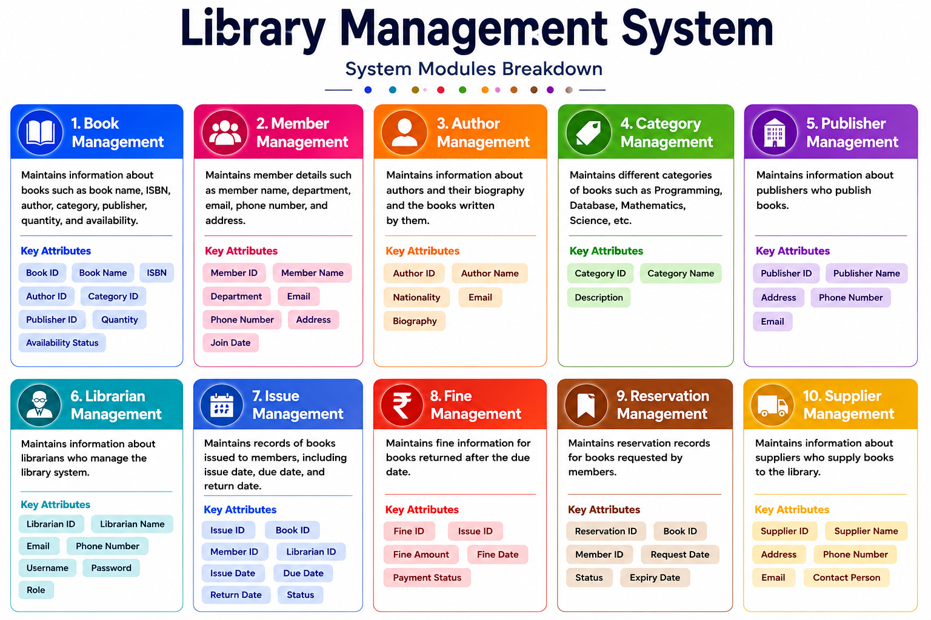
6

Slide 7
N
5. Entities and Attributes
10 entities identified for the proposed database
Entity | Key attributes
Book | Book_ID (PK), Book_Name, ISBN, Quantity, Available_Count, Author_ID (FK), Publisher_ID (FK), Category_ID (FK), Supplier_ID(FK)
Member | Member_ID (PK), Member_Name, Department, Email, Phone, Membership_Date
Author | Author_ID (PK), Author_Name, Email, Phone
Category | Category_ID (PK), Category_Name, Description
Publisher | Publisher_ID(PK), Publisher_Name, Email, Phone, Address
Next Slide
7

Slide 8
N
Entity | Key attributes
Librarian | Librarian_ID (PK), Librarian_Name, Email, Phone, Username
Issue | Issue_ID (PK), Book_ID (FK), Member_ID (FK), Librarian_ID (FK), Issue_Date, Due_Date, Return_Date
Fine | Fine_ID (PK), Issue_ID (FK), Fine_Amount, Payment_Status, Payment_Date
Reservation | Reservation_ID (PK), Book_ID (FK), Member_ID (FK), Reservation_Date, Status
Supplier | Supplier_ID (PK), Supplier_Name, Email, Phone, Address
8

Slide 9
jj
6. Relationships and Cardinality
Relationship | Cardinality | Meaning
Author– Book | 1 : M | One Author can have many Books.
Publisher– Book | 1 : M | One Publisher can have many Books.
Category – Book | 1 : M | One Category can contain many Books.
Supplier– Book | 1 : M | One Supplier Can Supply Many Books,and each Book Supplied By a Primary Supplier.
Book– Issue | 1 : M | One Book can have many Issue records.
Member– Issue | 1 : M | One Member can have many Issue records.
NEXT SLIDE
9

Slide 10
Relationship | Cardinality | Meaning
Librarian - Issue | 1 : M | One libran can manage many issue records.
Member - Reservation | 1 : M | One member can make many reservation.
Book - Reservation | 1 : M | One book can have many reservation records.
issue - Fine | 1: 1 | One issue can have one fine record.
10

Slide 11
7. Relational Database Schema
AUTHOR | AUTHOR (Author_ID, Author_Name, Email, Phone) | PK: Author_ID
PUBLISHER | PUBLISHER (Publisher_ID, Publisher_Name, Email, Phone, Address) | PK: Publisher_ID
CATEGORY | CATEGORY (Category_ID, Category_Name, Description) | PK: Category_ID
SUPPLIER | SUPPLIER (Supplier_ID, Supplier_Name, Email, Phone, Address) | PK: Supplier_ID
BOOK | BOOK (Book_ID, Book_Name, ISBN, Quantity, Available_Count, Author_ID, Publisher_ID, Category_ID,Supplier_ID) | PK: Book_ID FK: Author_ID → AUTHOR(Author_ID) FK: Publisher_ID PUBLISHER(Publisher_ID) FK: Category_ID → CATEGORY(Category_ID) FK:Supplier_ID SUPPLIER(Supplier_ID)
NEXT SLIDE
11

Slide 12
MEMBER | MEMBER (Member_ID, Member_Name, Department, Email, Phone, Membership_Date) | PK: Member_ID
LIBRARIAN | LIBRARIAN (Librarian_ID, Librarian_Name, Email, Phone, User_Name) | PK: Librarian_ID
ISSUE | ISSUE (Issue_ID, Book_ID, Member_ID, Librarian_ID, Issue_Date, Due_Date, Return_Date) | PK: Issue_ID FK: Book_ID → BOOK(Book_ID) FK: Member_ID → MEMBER(Member_ID) FK: Librarian_ID → LIBRARIAN(Librarian_ID)
FINE | FINE (Fine_ID, Issue_ID, Fine_Amount, Payment_Status) | PK: Fine_ID FK: Issue_ID → ISSUE(Issue_ID)
RESERVATION | RESERVATION (Reservation_ID, Book_ID, Member_ID, Reservation_Date, Status) | PK: Reservation_ID FK: Book_ID → BOOK(Book_ID) FK: Member_ID → MEMBER(Member_ID)
12

Slide 13
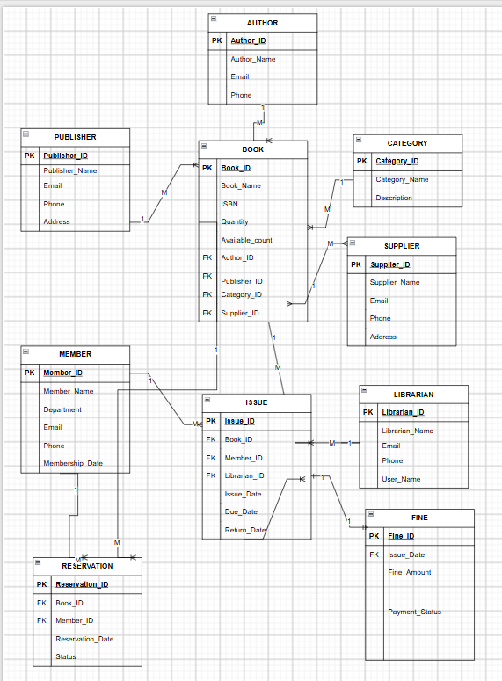
8. ER Diagram
Conceptual database design – 10 entities and their relationships
13

Slide 14
9. Team Responsibilities and GitHub
Team Member | Assigned responsibility
Student 1 | Project title, introduction, and problem statement, Objectives
Student 2 | Scope, and entity identification, Attributes, Primary Keys, and Foreign Keys,
Student 3 | Relationships and cardinality, Relational schema and ER diagram
Student 4 | GitHub repository and PPT documentation
GitHub Repository: Add the repository name and link here
14

Slide 15
10. Conclusion
The proposed Library Management System identifies ten major library entities.
The attributes, Primary Keys, and Foreign Keys have been identified.
The relationships and cardinalities between the entities have been defined.
The ER diagram and relational database schema have been designed.
The design will serve as the foundation for database implementation in Review–II.
Review–I Focus: Database Design
15

